Slide 1

TELECOM CHURN ANALYSIS
BY GROUP 6

Slide 2
PROBLEM STATEMENT:
Telecommunication companies often face problem with customer churn, which is the loss of customers who stop using their services. To solve this problem, companies need to identify the customers who are likely to unsubscribe their services and take pre-emptive measures to retain them. With the help of various Machine learning models, we can predict the customers who are most likely to churn, based on various factors such as customer usage patterns, payment history, and demographics.
PRIMARY PURPOSE:
The fundamental goal of these predictive models is to anticipate whether a telecommunications customer will cancel their subscription or not. These models provide a probability or binary classification label for each customer, indicating the probability of churn. This forecast can be quite useful for recognizing customers who may be considering leaving and implementing proactive strategies to keep them engaged.

Slide 3
converting all categorical variables into dummy variables.
Data Cleaning:
The dataset used in this project contains 21 columns and 7,043 rows. The first step in the data cleaning process was to remove any missing values in the dataset.
Converting churn predictor variable to binary numeric value.

Slide 4
Now we perform the DATA VISUALIZATION on the data to get the insights about the customer churn based on following factors.
Distribution of Churn
Distribution of Monthly Charges
Churn by Contract Type
Churn by Gender
Churn by Internet Service Type
Tenure vs Churn
Correlation Heatmap

Slide 5
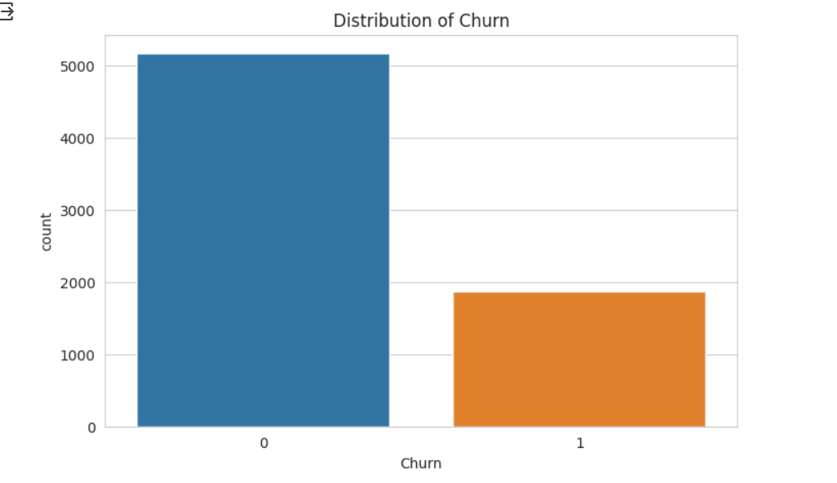
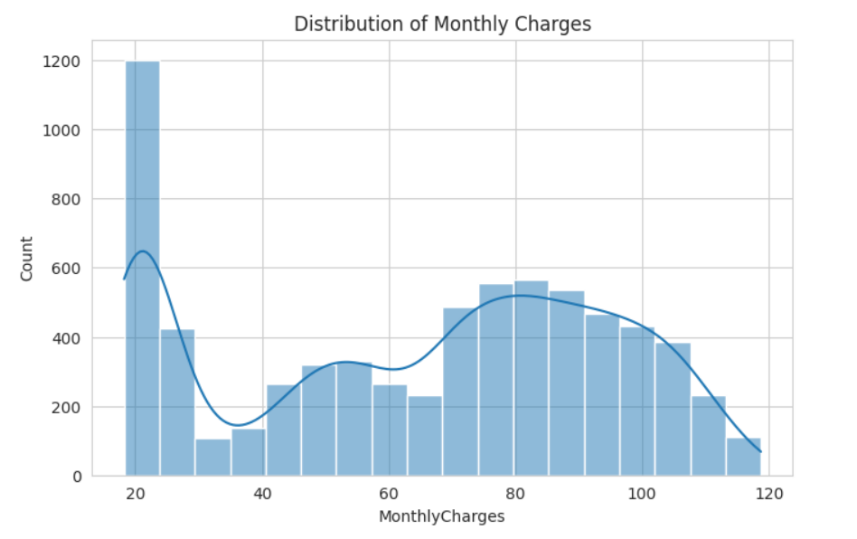
Distribution of monthly charges:
We can see that more number of customers were using the basic monthly charges of 20.
Distribution of churn:
This graph gives the overall churn distribution in the data.

Slide 6
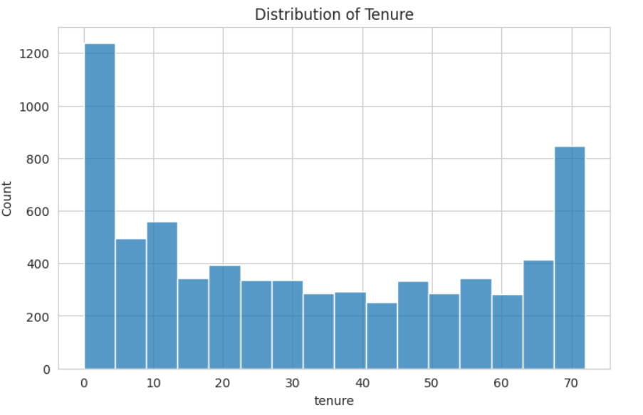
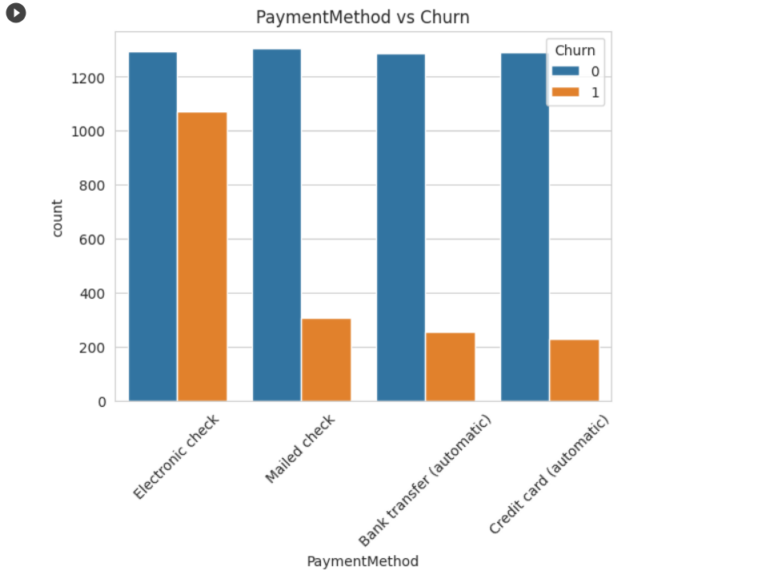
Payment method vs churn:
The churn rate is more in the electronic check payment method.
Distribution of tenure:
We can understand that more customers were not long term but have shorter tenure.

Slide 7
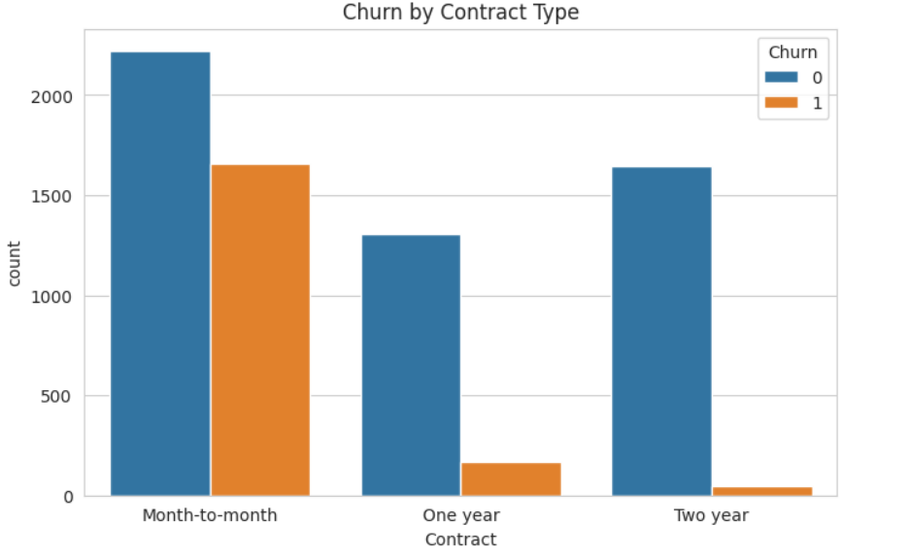
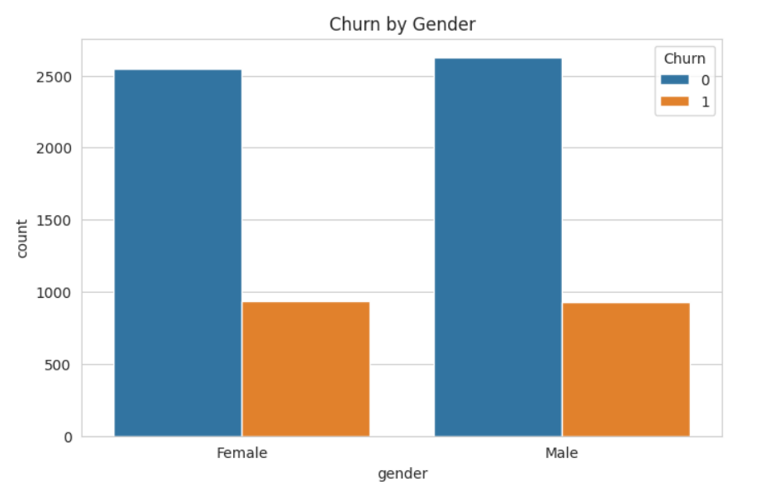
Churn by gender:
Churn rate is almost similar in both the genders from the following graph.
Churn by contract type:
We can see that month-to-month contract type have higher churn value than other two criteria.

Slide 8
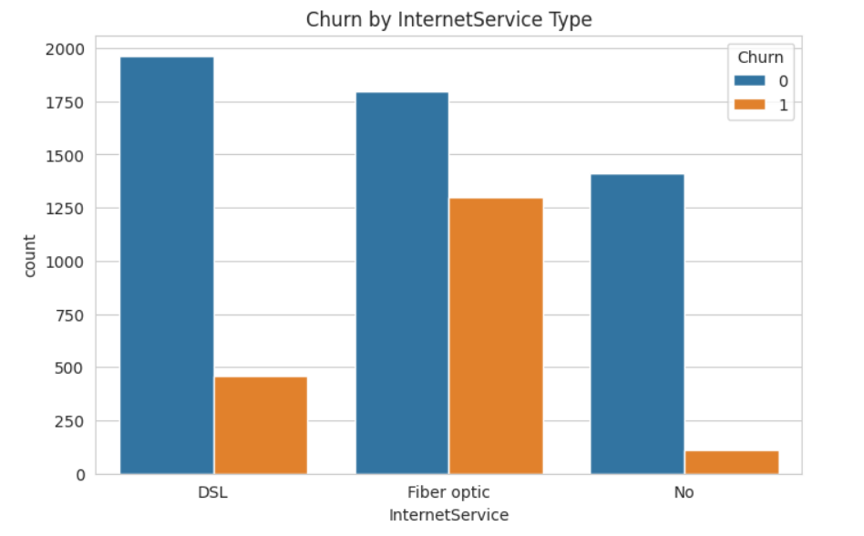
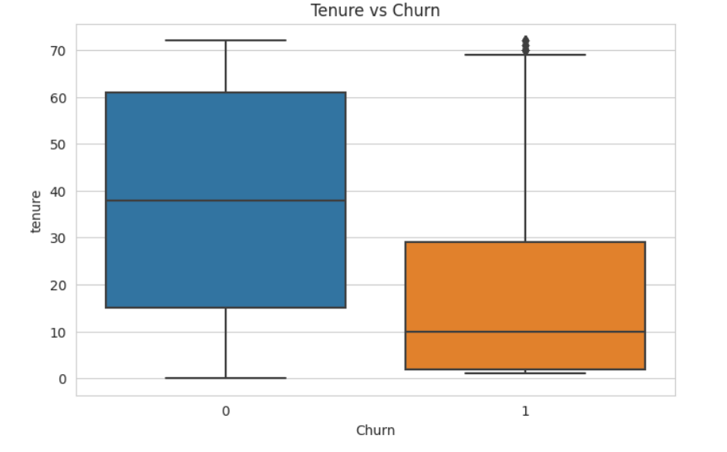
Tenure vs churn:
Customers who have been with the company for a longer tenure are less likely to churn compared to customers with shorter tenure.
Churn by Internet Service type:
We can deduce the Fiber optic internet service has high churn rate.

Slide 9
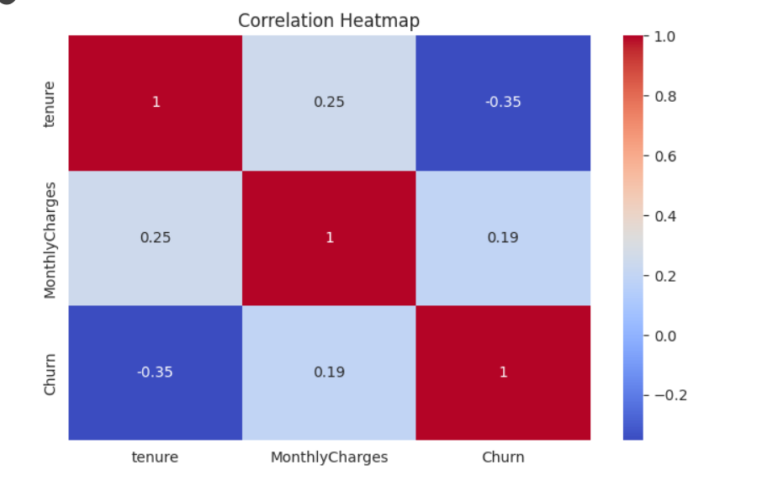
Correlation Heatmap:
We have used the correlation heatmap on the variables like tenure, monthly charges and churn as we cannot use categorical variables in heatmap, we used the numerical variables.

Slide 10
After the data visualization we defines two functions for visualizing the performance of classification models:
-“plot_confusion_matrix” Function:
It calculates the confusion matrix between the true and predicted labels using the confusion_matrix function from scikit-learn.
The function then creates a heatmap visualization of the confusion matrix using Seaborn's heatmap function. The heatmap provides a visual representation of the number of true positives, true negatives, false positives, and false negatives.
-“plot_roc_curve” Function:
It calculates the Receiver Operating Characteristic (ROC) curve and the Area Under the Curve (AUC) score.
The ROC curve is a plot of the True Positive Rate (TPR) against the False Positive Rate (FPR) at various threshold values. It shows the trade-off between sensitivity and specificity of a classification model.
The function plots the ROC curve using Matplotlib, with the AUC value included in the legend.

Slide 11
Models:
When tackling a classification problem, there is no one-size-fits-all algorithm. We explore various models and ultimately select the most suitable one based on accuracy and F1 score, aiming for the highest achievable performance.
In our evaluation process, we considered the following models:
Logistic Regression
Decision Tree Classifier
Random Forest Classifier
K-Nearest Neighbors (KNN)
Naive Bayes Classifier
After careful assessment, we determined the best-performing model to address our specific problem and maximize both accuracy and the F1 score.

Slide 12
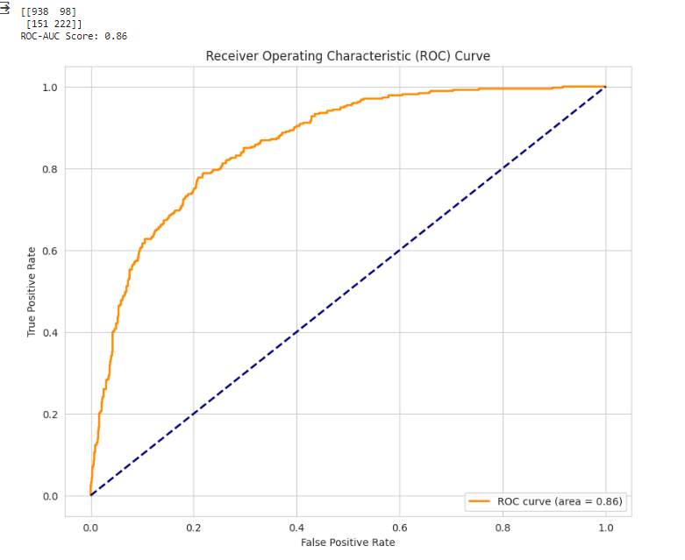
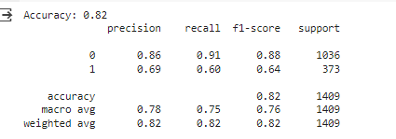
Based on the accuracy:
We can deduce that Logistic Regression has the highest accuracy out of all with 0.82 and with an ROC curve area of 0.84.

Slide 13
Conclusion:
In conclusion, this project aimed to predict customer churn in the telecom industry using a machine learning model. The dataset was cleaned by removing duplicates and imputing missing values. Exploratory Data Analysis was performed to analyze the distribution of the independent variables and the target variable. Five models were used to predict customer churn, and the Logistic Regression model had the highest accuracy, F1-score and ROC curve area.

